Slide 1
Student study planner
CAPSTONE PROJECT
Presented By:
Name - Anmol Shukla
College Name – DSEU, Rajokari Campus
Department – CS-A

Slide 2
OUTLINE
Problem Statement
System Development Approach
Algorithm & Deployment (Step by Step Procedure)
Result
Conclusion
Future Scope(Optional)
References

Slide 3
Problem Statement
Students often feel unorganized with multiple subjects, assignments, and exams.
Missing deadlines and last-minute study leads to stress and poor results.
A simple planner is needed to:
Organize tasks.
Track progress.
Set reminders.
Build consistency in study habits.

Slide 4
System Approach
User-Friendly Design: Simple interface for quick task entry.
Task Scheduling: Students can add subjects, deadlines, and exam dates.
Progress Tracking: Shows completed vs. pending tasks at a glance.
Reminder System: Alerts for important study sessions and deadlines.
Data Handling: Stores study plans locally or in a database.

Slide 5
Algorithm & Deployment
Students enter subjects, assignments, and exams.
Planner generates timetable and sets reminders.
Tasks are marked as done/pending, progress is updated.
Reports show daily/weekly completion.
Built with HTML, CSS, JS (frontend) and LocalStorage/SQLite (backend optional).
Tested for responsiveness and browser compatibility.
Deployed on GitHub Pages / Netlify (static) or Heroku/Vercel (dynamic).

Slide 6
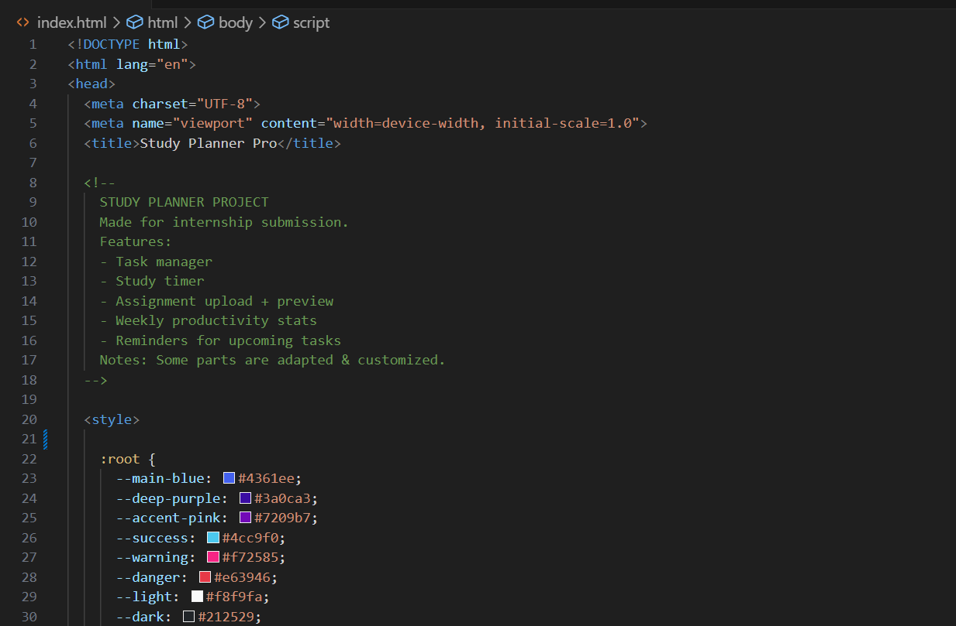
Result

Slide 7
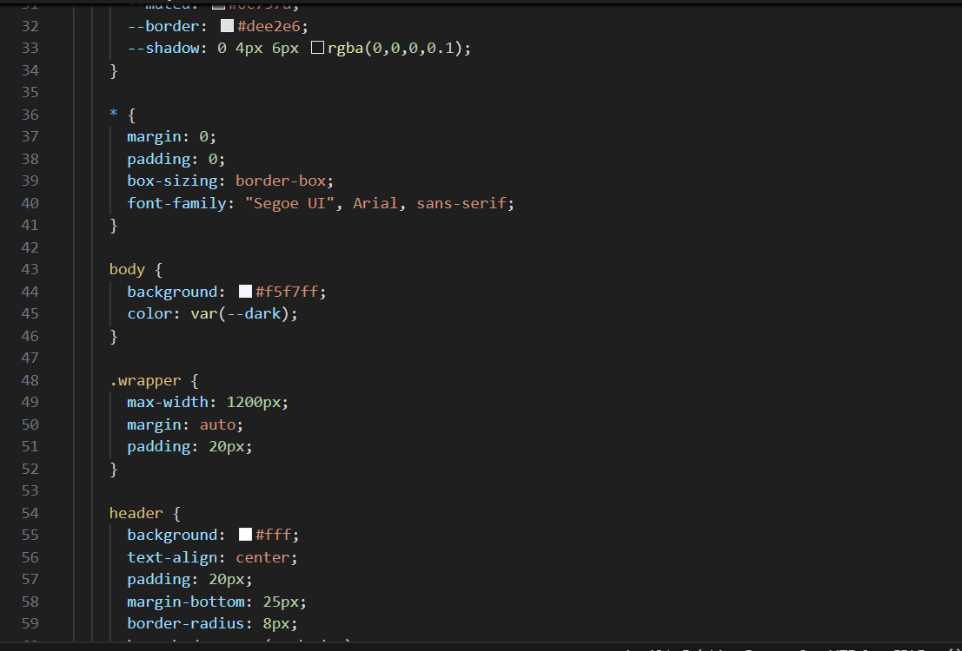
Result

Slide 8
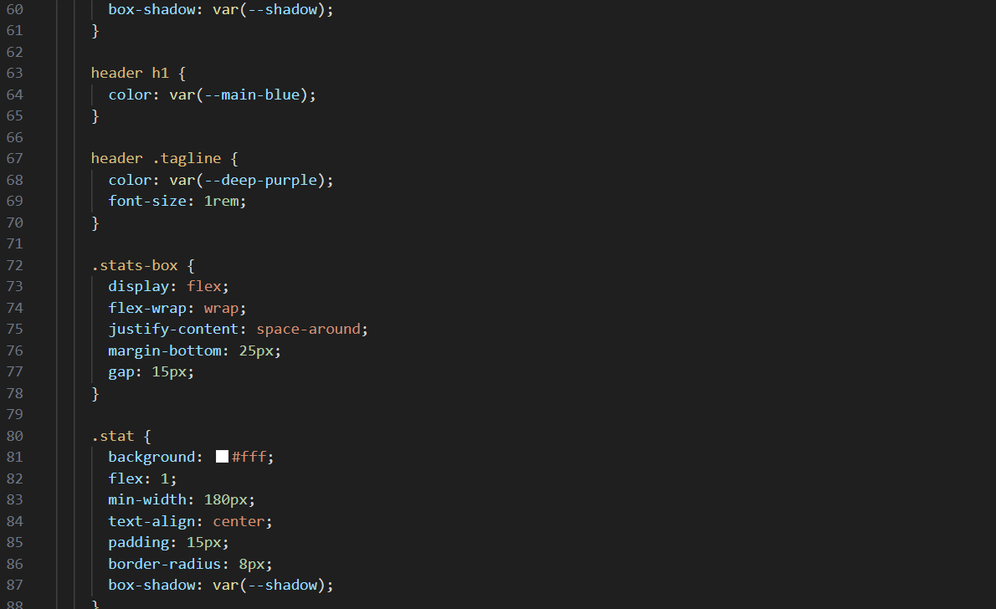
Result

Slide 9
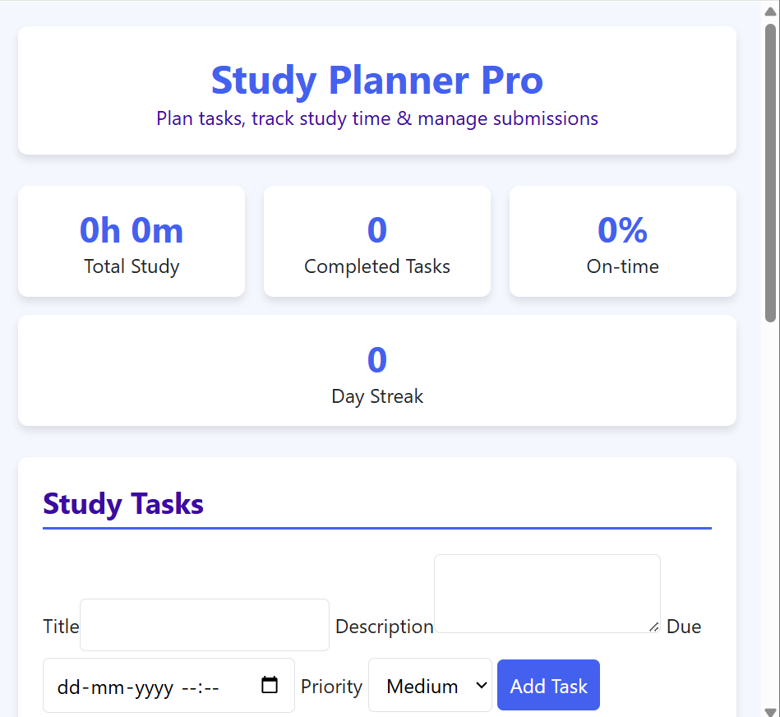
Result

Slide 10
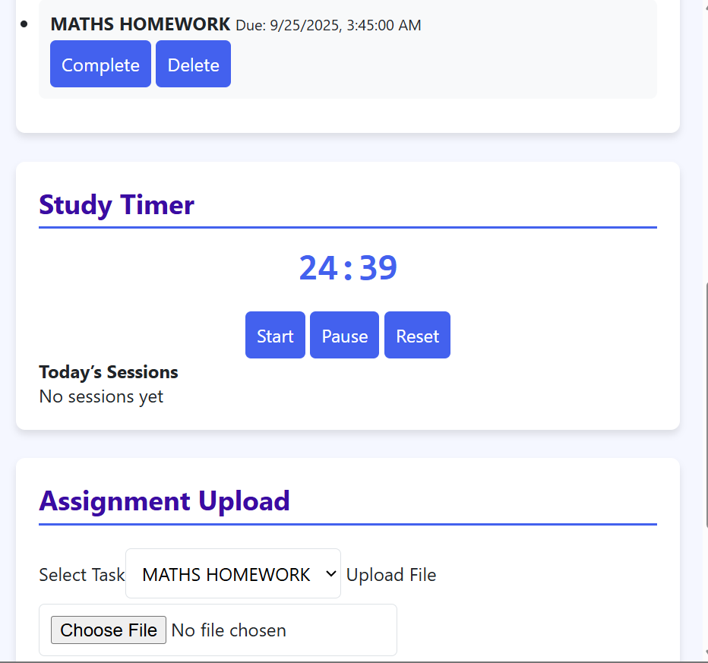
Result

Slide 11
Github and deployment link
Git Hub Link: https://github.com/AnmolShukla15/
Deployment Link: https://student-study-planner-ebon.vercel.app/

Slide 12
Conclusion
Provides a cost-effective online presence for small businesses.
Eliminates dependency on complex e-commerce platforms.
Offers an engaging and interactive customer experience.

Slide 13
References
NanthiniMoha/TNSDC-FWD-DIGITAL_PORTFOLIO
Get started with Bootstrap · Bootstrap v5.3
W3Schools – HTML, CSS, JavaScript Tutorial – https://www.w3schools.com/
MDN Web Docs – Web APIs and Local Storage – https://developer.mozilla.org/
GeeksforGeeks – JavaScript Basics – https://www.geeksforgeeks.org/javascript/

Slide 14
THANK YOU

